Slide 1
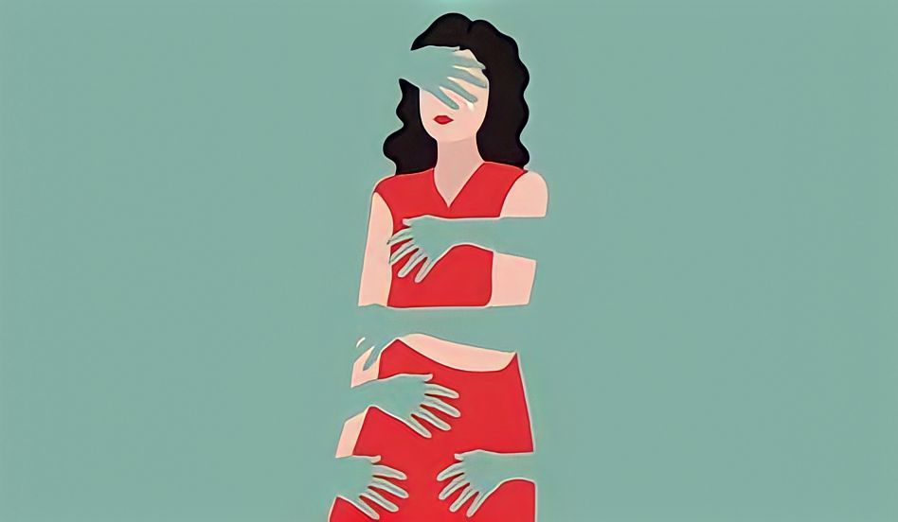
Violence against women
«Violence against women is an appalling human rights violation. But it is not inevitable. We can put a stop to this.»
(Nicole Kidman)

Slide 2

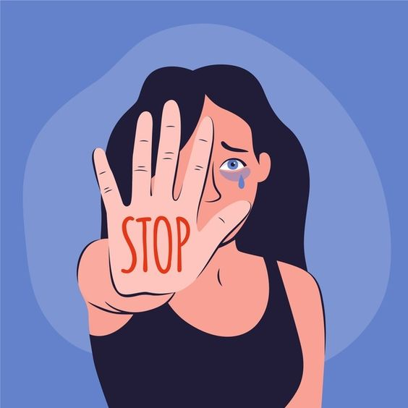
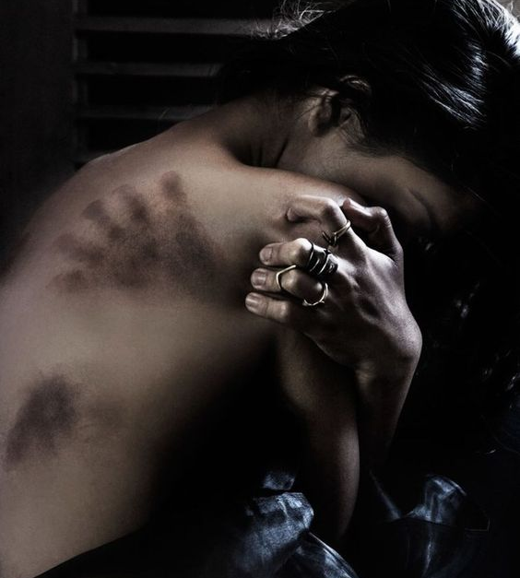
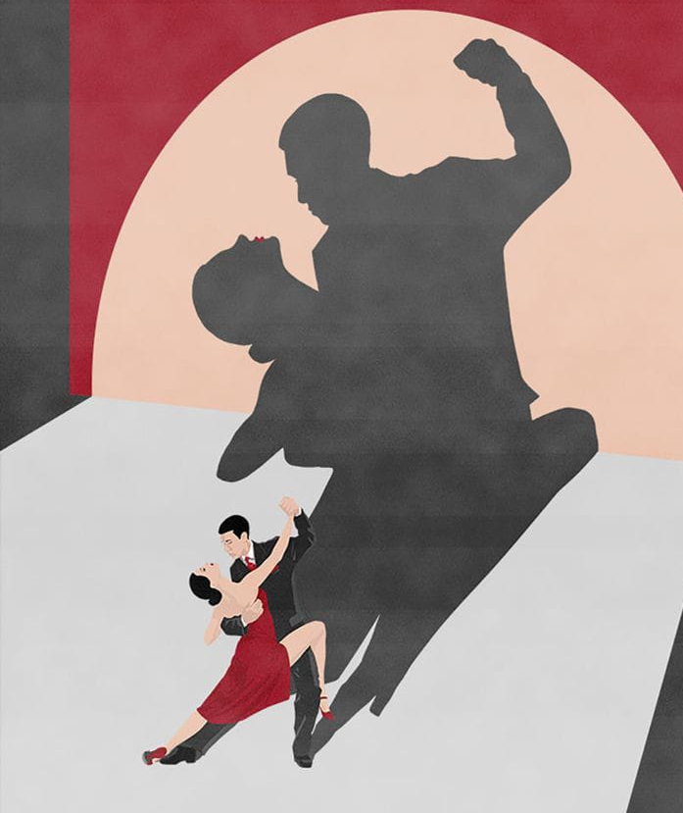
What is violence against women?
Every act of gender-based violence that causes physical, sexual or psychological harm or suffering to women, including threats, is violence against women.
ONU chose November 25th as the international day for the elimination of violence against women.
There are three types of violence: physical, verbal or psychological.
Moreover, women are exposed in public places and in the workplace to harassment or sexual abuse.

Slide 3
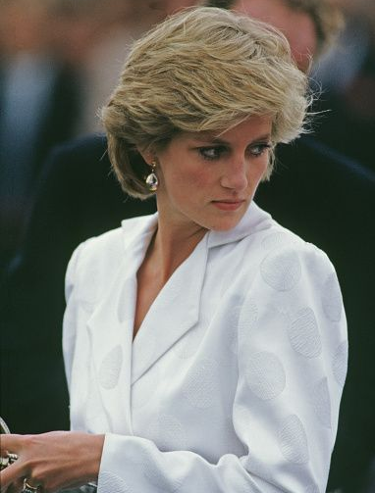
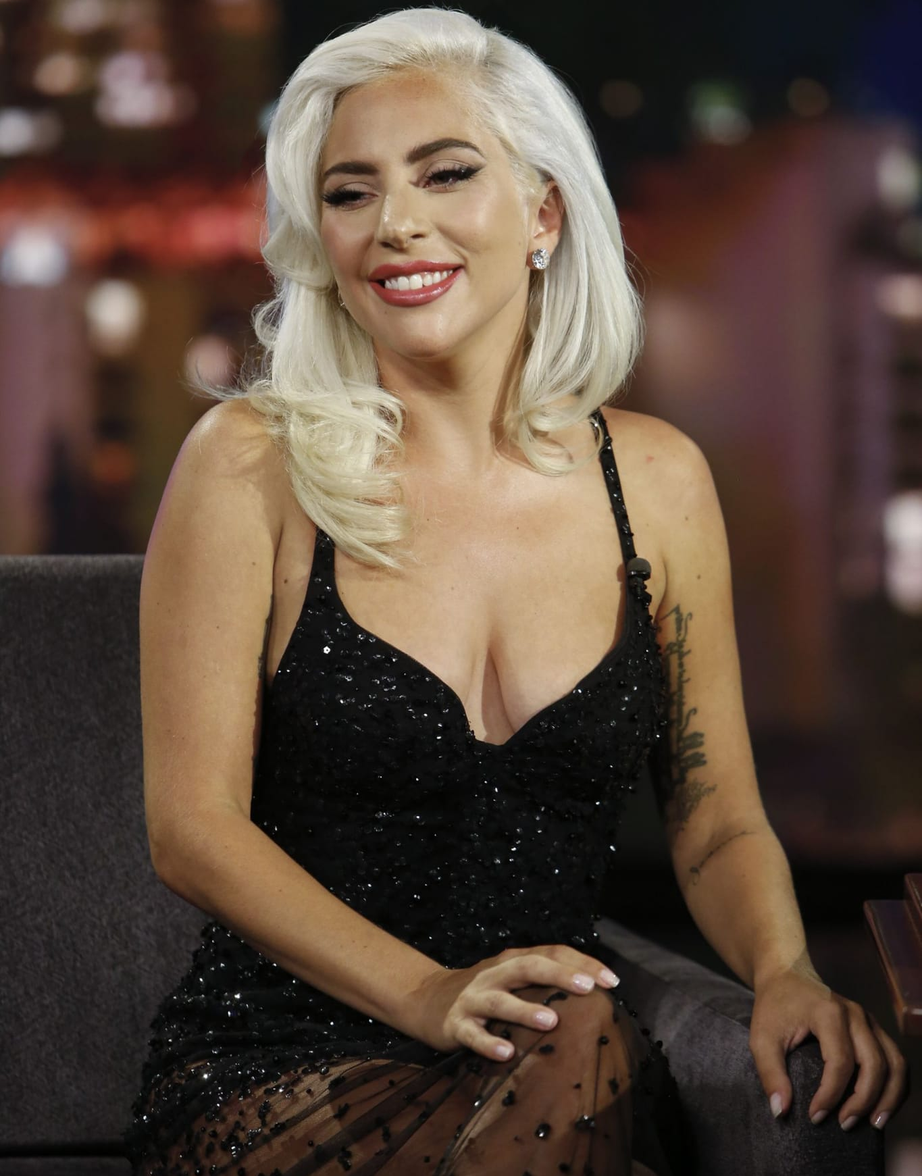
Examples of victims
Every woman could be a victim of a violence, even celebrities.
Lady Diana, the Princess of Wales, was victim of psychological violence by her husband King Charles III who always judged her body even though he knew she was bulimic when they were married.
"Inside me, I knew there was something wrong with me, but I was too immature to voice it."
Lady Gaga has been sexually assaulted by a music producer who left her pregnant.
“I was 19 years old, and I was working in the business, and a producer said to me, ‘Take your clothes off,’” she said. “And I said no. And I left, and they told me they were going to burn all of my music.
And they didn’t stop.
They didn’t stop asking me, and I just froze and – I don’t even remember.” She said “the person who raped me dropped me off pregnant on a corner”.

Slide 4
Our opinion
We think violence against women is a horrible thing which shouldn’t exist.It’s important to celebrate November 25th, and we should talk much more about this and make peopele aware of the problem.
Finally pay attention to those men who after some time try to change you, to maneuver you. Beware of violence that makes no noise and leaves no bruises, but still tears. Do not try to save those who cannot love. Save yourself instead.
-Ammaturo Matteo Edgardo
-D’Avanzo Emanuela
-Fiore Angela
-Infelice Elisa
-Miele Angela
-Siniscalchi Luisa
IIBL

